Slide 1
Tick4Tock

Slide 2
Hello!
We are Fan Sicheng
and Marcus Low
Presenting to you our proposal idea

Slide 3
Scenario
Imagine this...

Slide 4
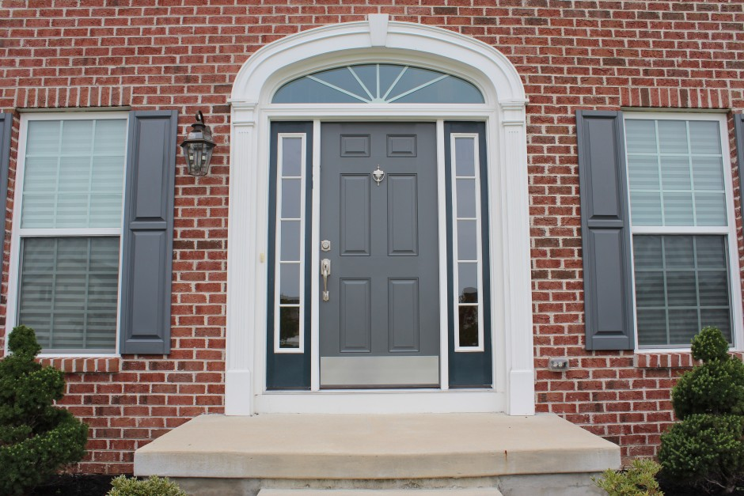
Notes:
You just came home from a long day at school, as you open the door...

Slide 5
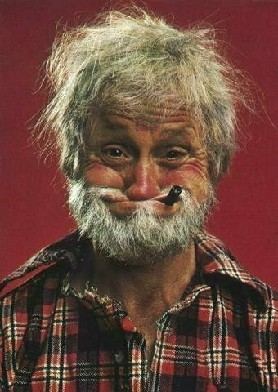
Notes:
Your crazy Uncle Dave runs out and yells “Good luck boy!”

Slide 6
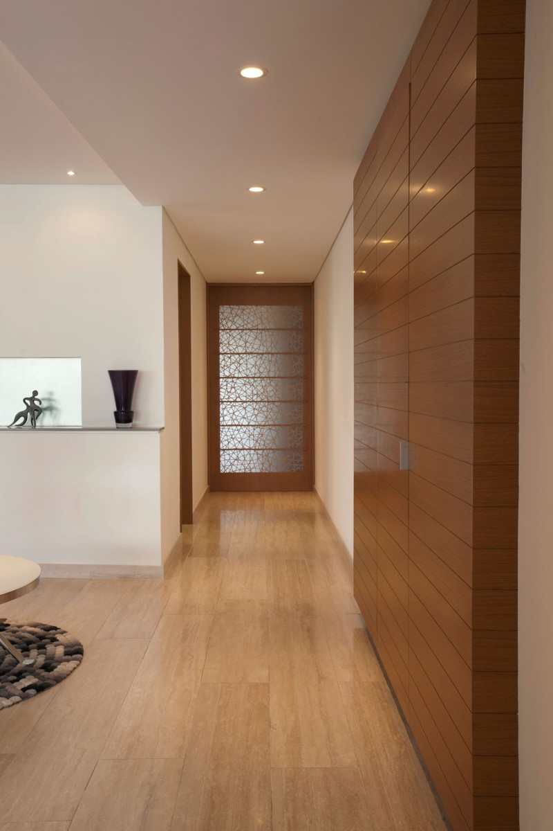
Notes:
Confused, you walk into the house, a stench engulfs you. You decide to follow the trail of the stench

Slide 7
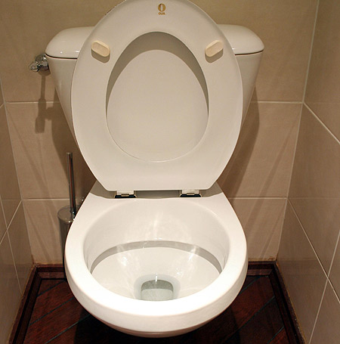
Censored
Notes:
You walk into the toilet, to realise that Uncle Dave let out a nuclear bomb. Your worst nightmare...

Slide 8
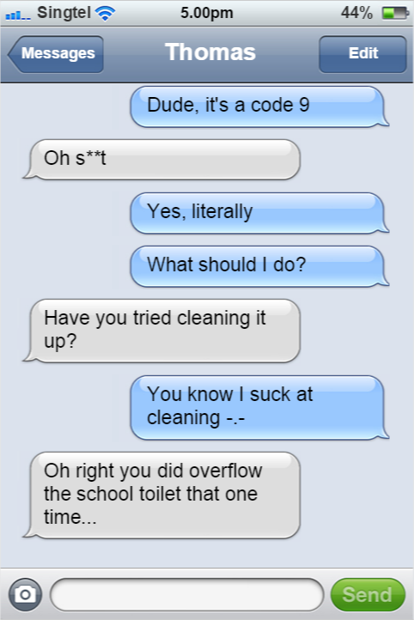
Notes:
You know full well you cannot clean anything. While at a loss, you decide to ask your friend Thomas for help <converse>

Slide 9
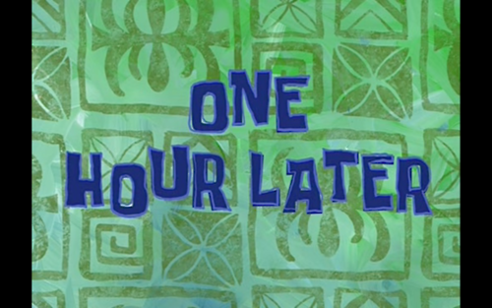

Slide 10
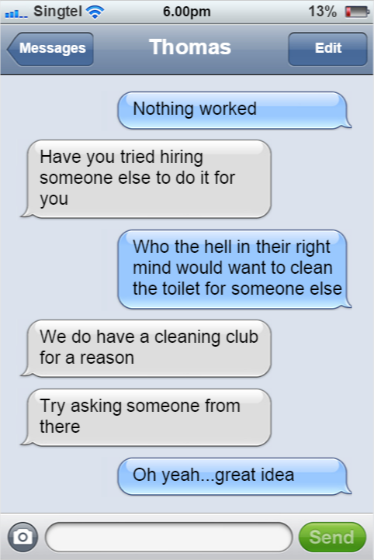

Slide 11
Another hour later...
Notes:
An hour later, you finally find someone from the cleaning club who is willing to help you

Slide 12
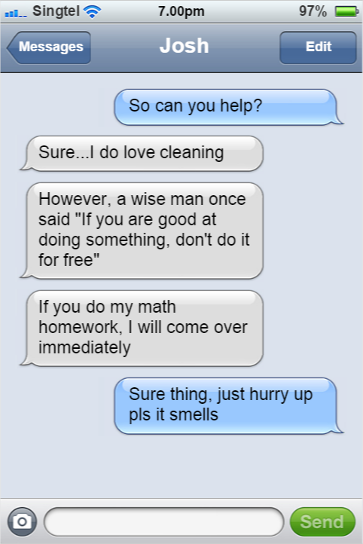
Notes:
After that, you gave him your address and he comes over and cleans your toilet while you do his math homework with ease.

Slide 13
Sure you solved your problem. But...
You took at least 2 hours just to have someone clean your s**t
You might not be so lucky as to have a Cleaning Club
You might not even be lucky enough to get someone like Josh who can help you
It there a way to simplify this process?

Slide 14
Introducing…
Tick4Tock
Smart name, eh?

Slide 15

Basic Idea
Trade in your time for someone else’s

Slide 16
Idea behind time trading
You need something done but don’t want to do it
You find someone to do it while you do something for him/her
Both of you get your things done

Slide 17
You can also pay the person in “Time Points” instead
Direct Trade
You do a favor for someone for a certain period of time. In exchange, the person does a favor for you in the same amount of time.
Time Points System
You pay someone the equivalent of how long they spend doing your work. Conversely, you earn according to how long you worked for others.

Slide 18
Methods of Payment
Direct Trade
Trade with Time Points to Compensate for Difference in Duration
Purely Time Points

Slide 19
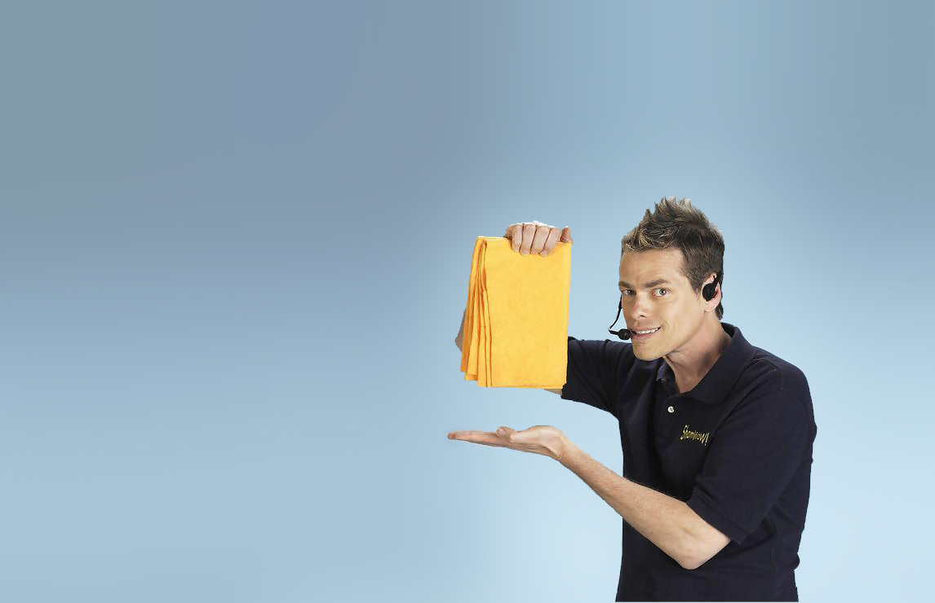
Mockups

Slide 20
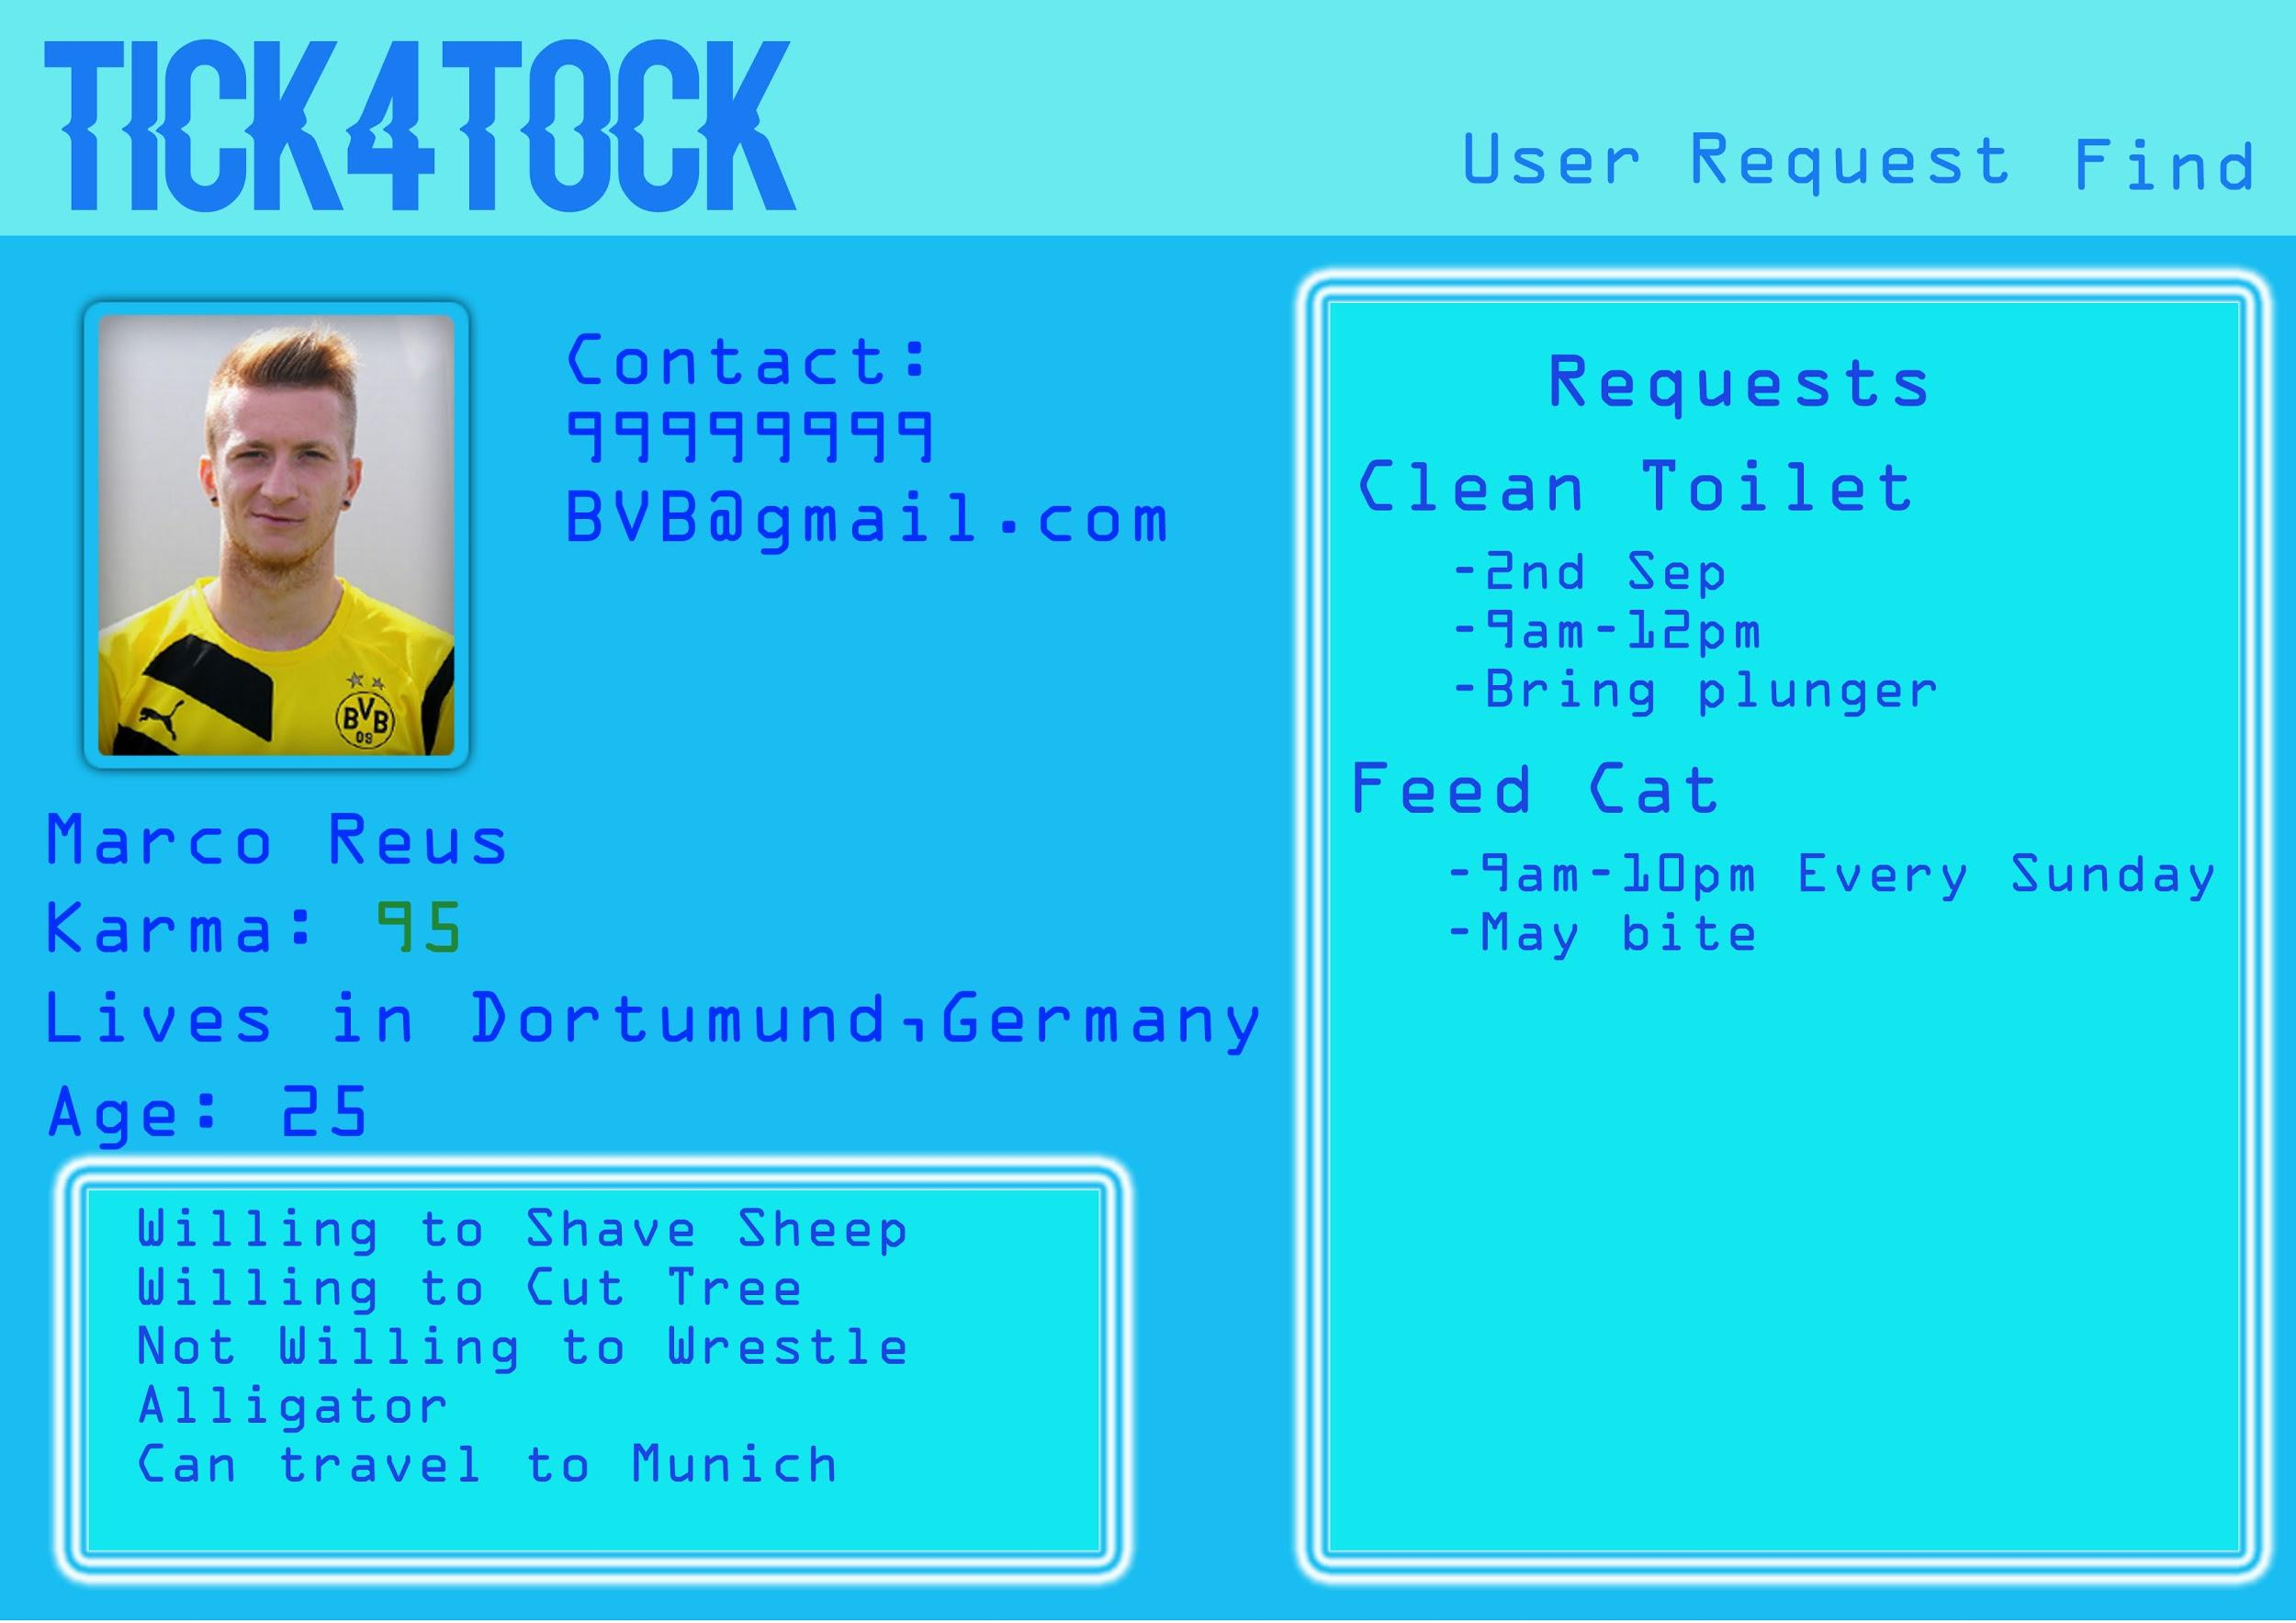

Slide 21
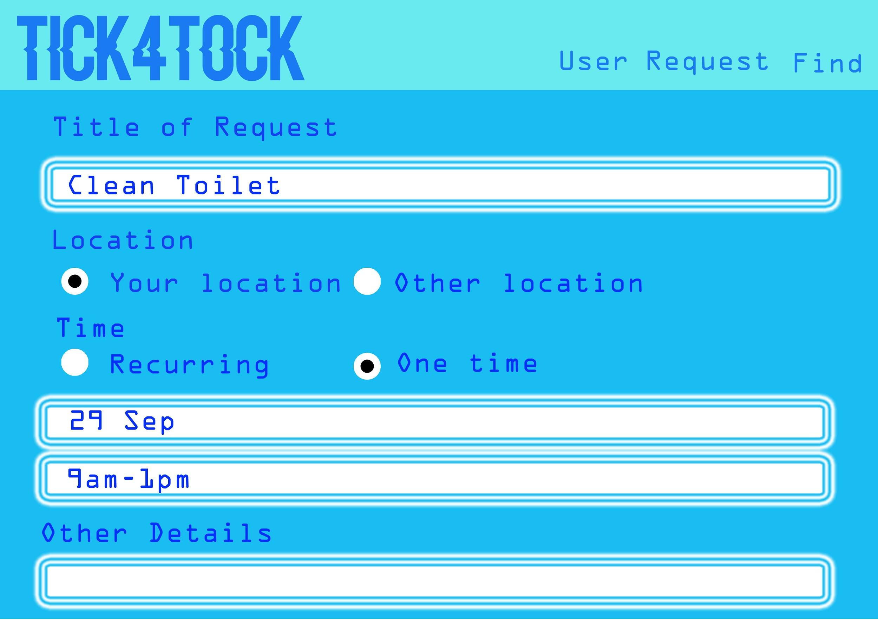

Slide 22
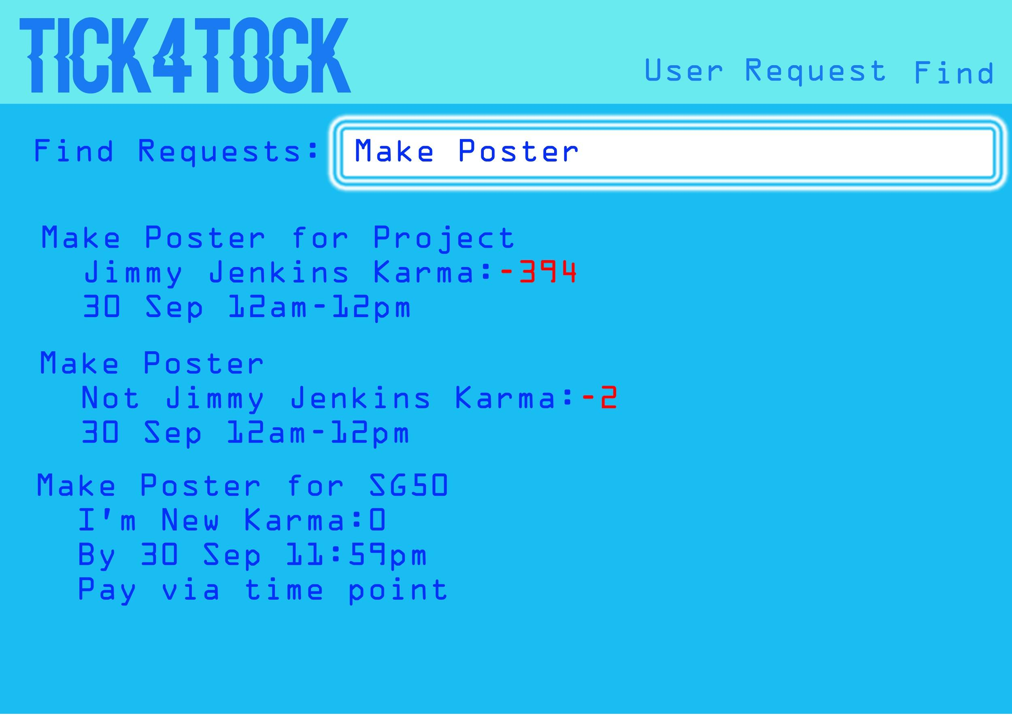

Slide 23
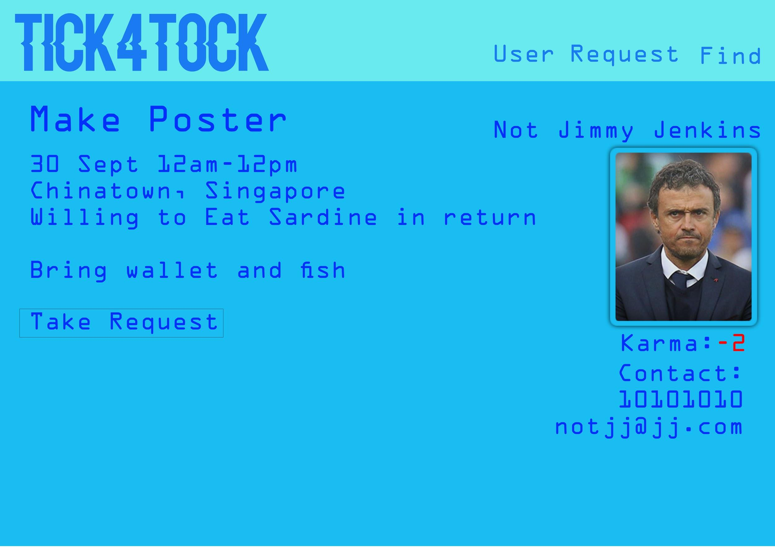

Slide 24
Potential Extensions
Trading time for money (i.e. making it a service buying platform)
Recommended requests to take up based on user’s past activities

Slide 25
Market Competition
Also known as “Why we can’t have nice things”

Slide 26
Time trading is not a new idea
However, they are not well known

Slide 27
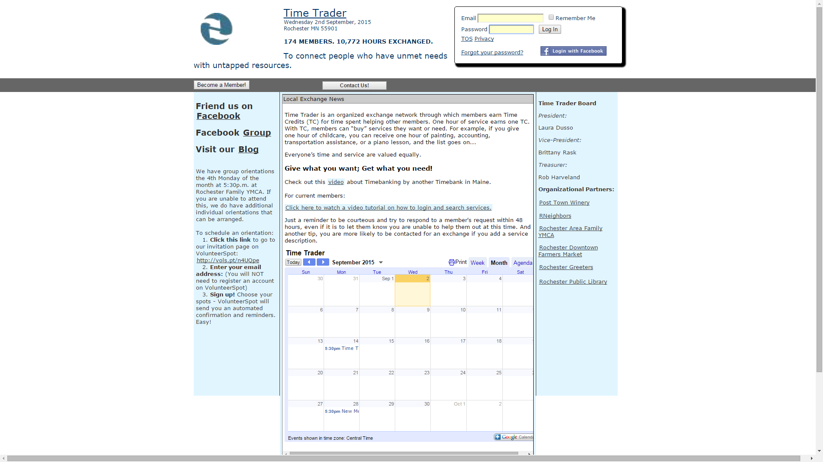
Time Trader

Slide 28
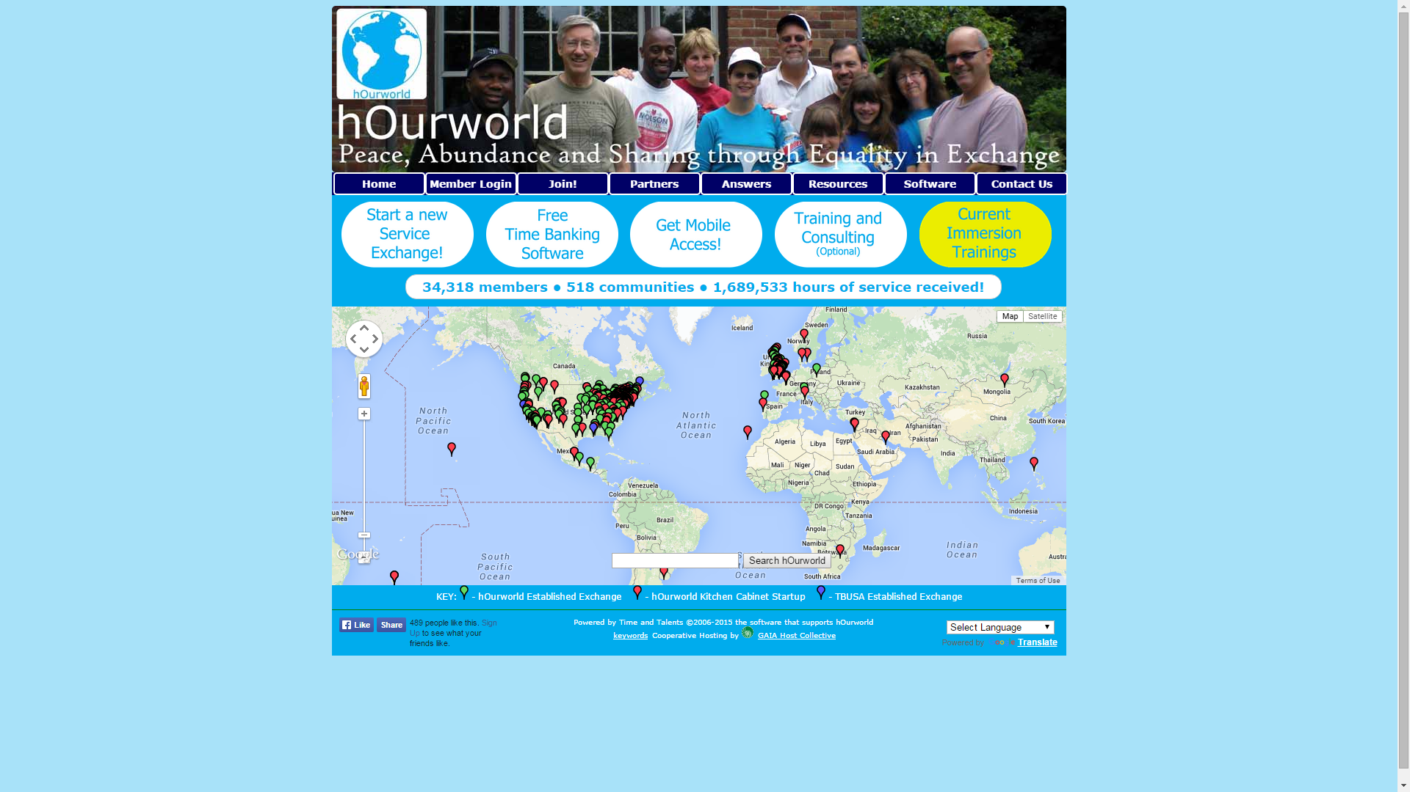
hOurworld

Slide 29
Key Differences
Time Trader
Uses Time Credit system
Limited to United States
hOurworld
Focused more on building communities of time traders as opposed to building a time bank itself
Spread across the world (although the only one in SEA is in Nababagay Giao)
Other Apps
Most use time credit system
Most have less users than the size of 1 RI class
Most are really outdated

Slide 30
Security Concerns
Oh boy

Slide 31
We understand there are security concerns regarding this idea
Trust us, we thought long and hard about this

Slide 32
Countermeasures
Age Requirement
Make sure users are responsible
Ensures certain level of safety
Social Media Linking
Better coverage than age requirement
Dependent on our ability as coders
Karma System
Awards better users with better reputation
Tracks some form of credibility

Slide 33
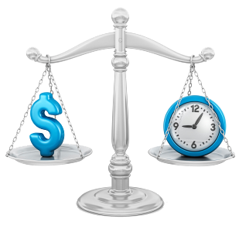
“Time is money.” -Benjamin Franklin

Slide 34
What do you want to do with your precious time?

Slide 35
Thanks!
Any questions?

